Slide 1


Automated Task Scheduling for Cloth and Deformable Body Simulations in Heterogeneous Computing Environments
Chengzhu He^{1,2}, Zhendong Wang², Zhaorui Meng¹, Junfeng Yao¹, Shihui Guo¹, Huamin Wang²
1.
2.
Notes:
Hello everyone.
Our paper “Automated Task Scheduling for Cloth and Deformable Body Simulations in Heterogeneous Computing Environments” discusses accelerating physical simulation via heterogeneous computing.

Slide 2
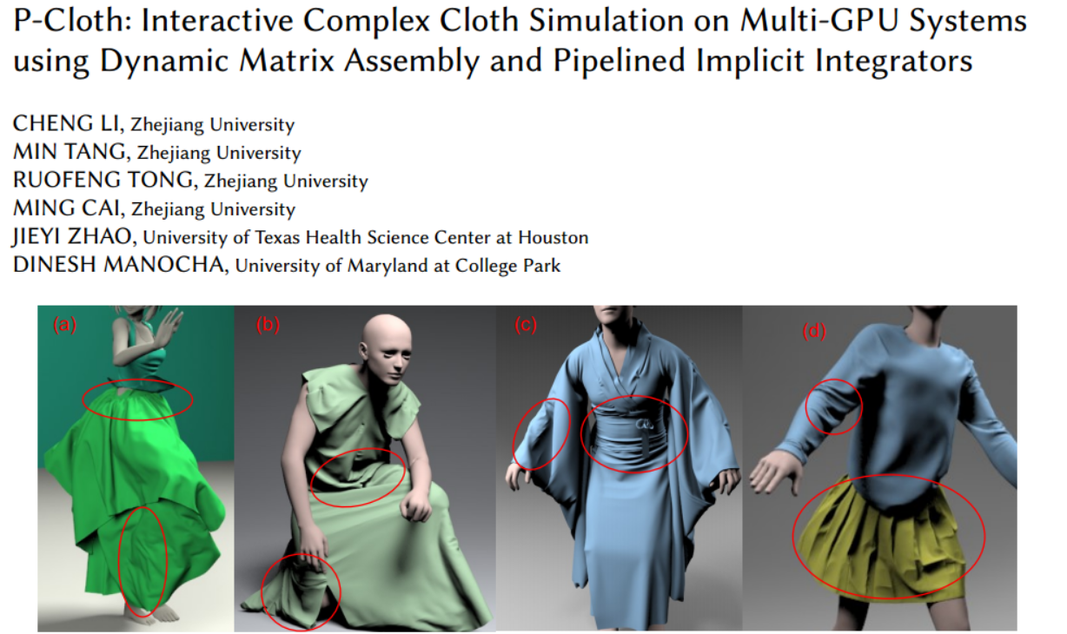
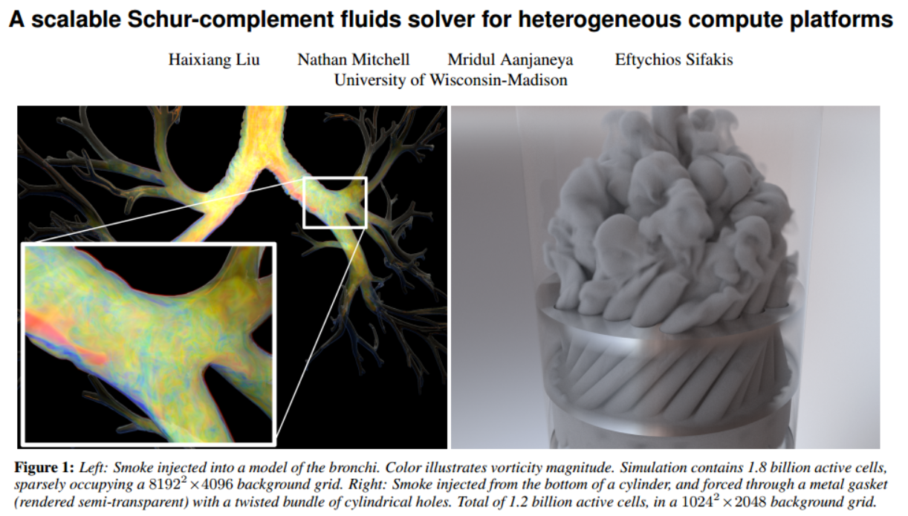
Heterogeneous computing in simulation
Communication delay: Large-scale scenarios
Carefully design task allocation strategies for each hardware/simulation system
NP-complete complexity
Dynamic system load
Highly serialized iterative tasks
Notes:
Physics simulation requires a large amount of computation, and a 【single device】 is difficult to meet the computing needs.
Therefore, people seek the help of multi CPU, multi GPU or heterogeneous devices. However, heterogeneous computing has the following challenges, which have led to less attention in previous research, including:
high communication latency between devices, and the latency is usually much higher than the computation time of a single task. This is also why most previous work on multi device acceleration focused on performance in large-scale senarios;
And in previous work, we needed to carefully design specialized task allocation strategies for each heterogeneous device and each task pipeline, which was not conducive to the universality;
However, in fact, the optimal allocation of tasks to heterogeneous devices is an NP Complete problem, so manual allocation strategies might become completely impossible;
And in simulation environment, the computation of tasks will change with the contact between objects, so scheduling needs to consider dynamic load balancing;
And last, the iterative tasks in simulation are usually executed completely serially, and parallelization may result in the loss of convergence rate

Slide 3
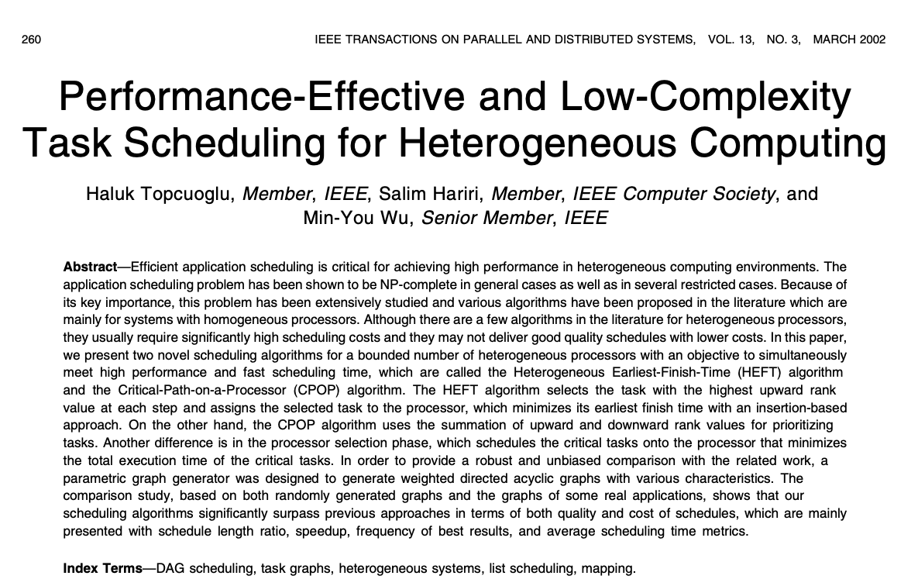
1. How do me make efficient task scheduling
Directly allocate each task equally to the device
Multivariate linear programming
Shortest fractal tree
Dijkstra's shortest path
……
HEFT: Heterogeneous Earliest Finish Time
Performant, Multi-Objective Scheduling of Highly Interleaved Task Graphs on Heterogeneous System on Chip Devices (publish in IEEE Transactions on Parallel and Distributed Systems, 2002)
Notes:
So, we first address the major problem, how to efficiently schedule tasks in heterogeneous environments. We have tried many solutions, including simple average thread segmentation, multivariate linear programming, shortest fractal trees, et cetera. Finally, we chose a method proposed in 2 thousand and 2 called HEFT, which stands for Heterogeneous Earlest finish time. Although this method appeared earlier, it is very suitable for our problem. In fact, this method is widely used in distributed computing, cloud computing and other scenarios, and we are the first to introduce it into computer graphics.

Slide 4
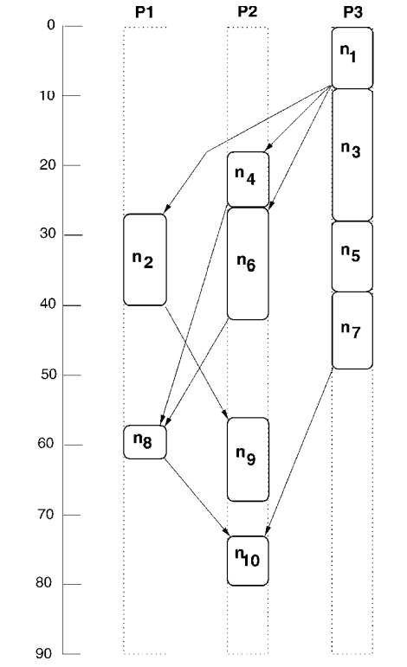
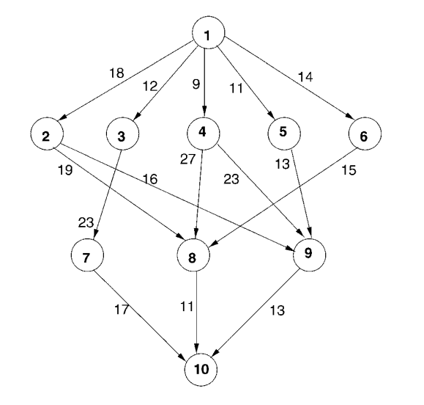
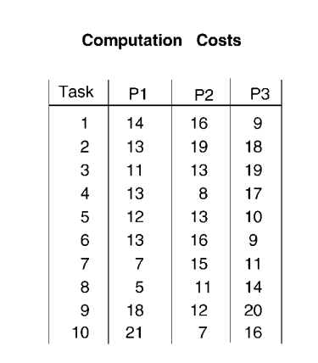
HEFT algorithm
Notes:
The HEFT algorithm can easily handle dependencies between tasks. Given the dependencies between tasks and the computation matrix of each task on each device, we can finally create a scheduling map, which represents which time each task will be executed on which device. We take the calculation process of XPBD as an example to demonstrate the calculation process of HEFT.

Slide 5
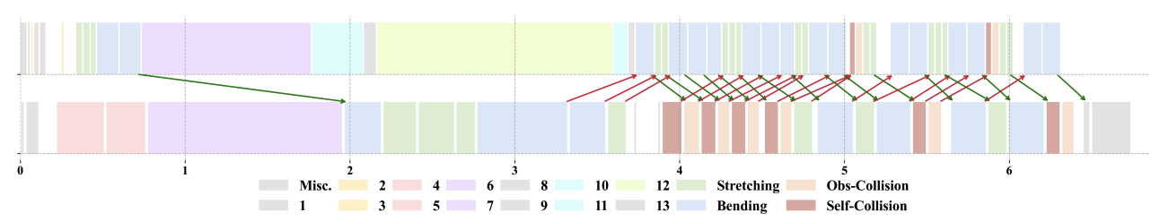
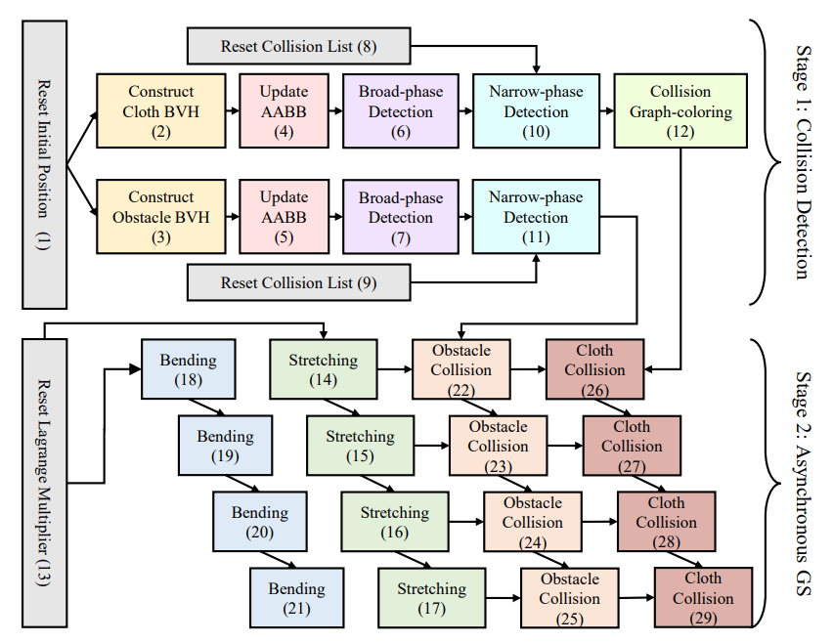
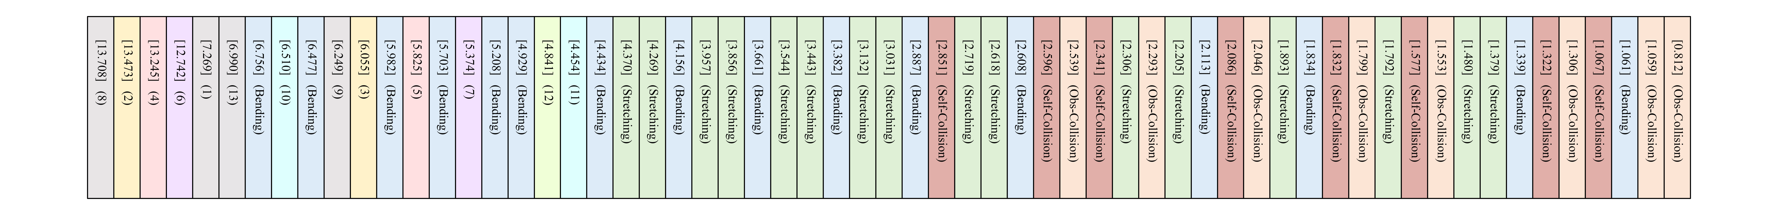
HEFT in simulation (XPBD example)
Insert into Heterogeneous devices based on Earliest-Finish-Time
DAG of XPBD
Ranku Calculation:
Topology sorting
Notes:
Firstly, we use directed acyclic graphs (DAGs) as needed to represent the dependencies between tasks, such as the broadphase collision detection that needs to be completed before the narrow collision detection .
Then we perform topological sorting on the DAG, which generates an ordered table that ensures the dependencies between tasks.
Based the ordered list of topological sorting, we calculate the ranku value of each task. Ranku quantifies the dependency of each task. If a task has more subsequent tasks, it represents a higher degree of dependency, that is, its ranku value will also be higher.
In the future, it will be prioritized for scheduling to minimize waiting delay.
Finally, we traverse the task list sorted in reverse order by Ranku, and calculate the EFT of each task on different devices, which is the earliest completion time. We use the device with the smallest EFT value as the inserted device.
Tasks with higher value of ranku will be prioritized for scheduling, thus minimizing the delay of data transmission to the greatest extent possible

Slide 6
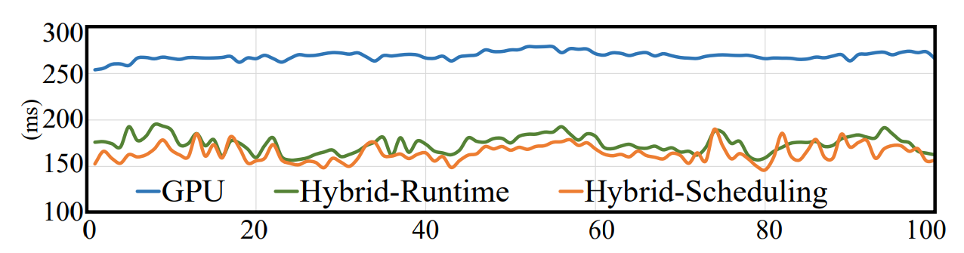
Scheduling performance
Universal
Efficient: Scheduling time < 0.1ms
Runtime Performance
Notes:
So why is the HEFT algorithm suitable for our problem? Because the algorithm is universal enough: HEFT can be easily extended to other computing pipelines, as long as the dependency relationships of tasks are given, we can obtain the computation matrix of tasks by running them several times on each device, which allows for scheduling without the need for other adaptations.
In addition, the algorithm is efficient enough: as HEFT is a heuristic algorithm, the cost of executing a scheduling is less than zero point one mili-seconds 0.1ms. Therefore, for simulation tasks, we can dynamically adjust and reschedule the computation matrix based on the actual execution time of the task to adapt to load changes caused by factors such as contact
This figure shows the curve of the ideal scheduling time and the actual running time after rescheduling each frame in 100 frames. It can be observed that the two times are very close, and the computation time is much smaller than that of the single GPU excecution.

Slide 7
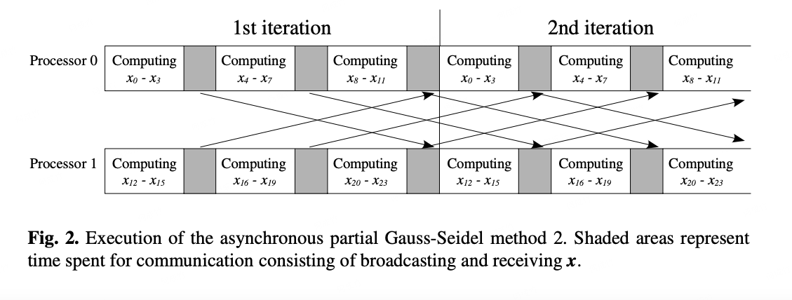
2. How to handle almost purely serial iterative processes
Asynchronous Iteration
Color 1
Color 2
Color ……
Color N
Stretching
Bending
Obstacle Collision
Cloth Collision
[Experiments on Asynchronous Partial Gauss-Seidel Method]
Stretching
Bending
Obstacle Collision
Cloth Collision
Worse convergence
Stretching
Bending
Obstacle Collision
Cloth Collision
Stretching
Bending
Obstacle Collision
Cloth Collision
Notes:
Then we need to address the second question, which is how do we handle iterative tasks that are almost entirely serial?
For example, for XPBD, we need to perform many Gauss-Seidel iterations, each iteration requiring serial traversal of different constraints and different color blocks of the same constraint.
Of course, constraints within the same color block can be executed in parallel, but the parallel granularity is too small to warrant further splitting.
To enhance the parallelism of Gauss Seidel iteration, we employed an asynchronous iteration strategy, which allows for a certain degree of overlap in the timeline. However, using this asynchronous iteration directly results in poor convergence of the system. Therefore, we made a lot of optimizations to maximize the parallelism and convergence rate of asynchronous iteration

Slide 8
Maximize parallelism and convergence
1. Integrating asynchronous iteration into HEFT's scheduling framework
Color 1
Color 2
Color ……
Color N
Reset Collision List (8)
Construct
Cloth BVH
(2)
Update AABB
(4)
Broad-phase Detection
(6)
Narrow-phase Detection
(10)
Collision
Graph-coloring
(12)
Reset Initial Position (1)
Stage 1: Collision Detection
Stretching
Bending
Obstacle Collision
Cloth Collision
Construct Obstacle BVH
(3)
Update AABB
(5)
Broad-phase Detection
(7)
Narrow-phase Detection
(11)
Reset Collision List (9)
Stretching
Bending
Obstacle Collision
Cloth Collision
Stretching
Bending
Obstacle Collision
Cloth Collision
Stretching
Bending
Obstacle Collision
Cloth Collision
Reset Lagrange Multiplier (13)
Stretching
Bending
Obstacle Collision
Cloth Collision
Stage 2: Asynchronous GS
Stretching
Bending
Obstacle Collision
Cloth Collision
Stretching
Bending
Obstacle Collision
Cloth Collision
Stretching
Bending
Obstacle Collision
Cloth Collision
Notes:
Firstly, we integrated these numerical iteration tasks into the HEFT scheduling framework, so that we can fully utilize the advantages of the automatic scheduling framework such as automated load balancing and dependency relationship assurance, allowing us to focus on the parallelization and decomposition of the iteration tasks themselves

Slide 9
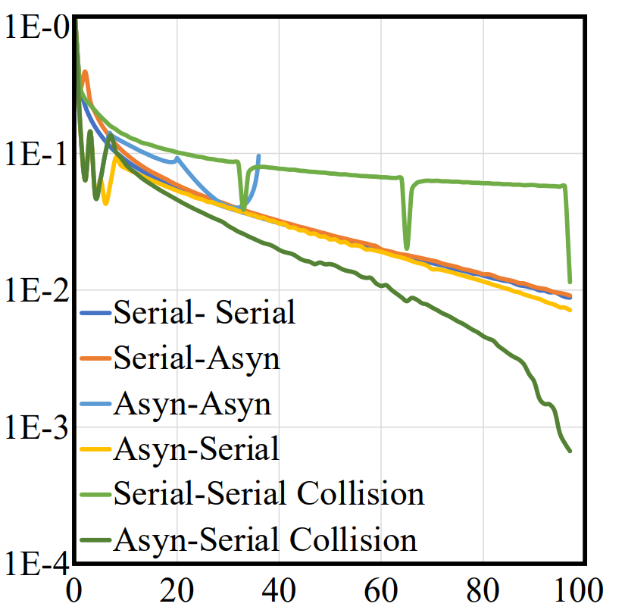
Maximize parallelism and convergence
2. For DAG: Designed and compared different task overlap strategies
Intra iteration asynchronous
Inter iteration asynchronous
Reset Collision List (8)
Reset Collision List (8)
Construct
Cloth BVH
(2)
Update AABB
(4)
Broad-phase Detection
(6)
Narrow-phase Detection
(10)
Collision
Graph-coloring
(12)
Construct
Cloth BVH
(2)
Update AABB
(4)
Broad-phase Detection
(6)
Narrow-phase Detection
(10)
Collision
Graph-coloring
(12)
Reset Initial Position (1)
Stage 1: Collision Detection
Reset Initial Position (1)
Stage 1: Collision Detection
Construct Obstacle BVH
(3)
Update AABB
(5)
Broad-phase Detection
(7)
Narrow-phase Detection
(11)
Construct Obstacle BVH
(3)
Update AABB
(5)
Broad-phase Detection
(7)
Narrow-phase Detection
(11)
Reset Collision List (9)
Reset Collision List (9)
Stretching
Bending
Obstacle Collision
Cloth Collision
Bending
(18)
Stretching
(14)
Obstacle Collision
(22)
Cloth Collision (26)
Reset Lagrange Multiplier (13)
Stretching
Bending
Obstacle Collision
Cloth Collision
Stage 2: Asynchronous GS
Bending
(19)
Stretching
(15)
Obstacle Collision
(23)
Cloth Collision
(27)
Reset Lagrange Multiplier (13)
Stage 2: Asynchronous GS
Stretching
Bending
Obstacle Collision
Cloth Collision
Bending
(20)
Stretching
(16)
Obstacle Collision
(24)
Cloth Collision
(28)
Bending
(21)
Stretching
(17)
Obstacle Collision
(25)
Cloth Collision
(29)
Stretching
Bending
Obstacle Collision
Cloth Collision
Notes:
Then, we designed and evaluated task overlap strategies with varying degrees of inter iteration and intra iteration asynchrony, and summarized an overlap strategy that satisfies both convergence and parallelism requirements. Specifically, we do not require strict serial execution of inter iteration tasks, but only require collision constraints within the iteration to be executed after stretching and bending constraint

Slide 10
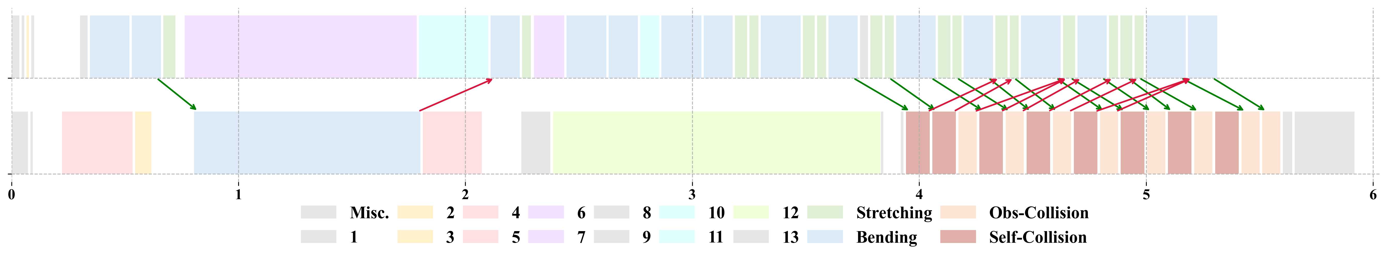
Maximize parallelism and convergence
3. Gauss-Seidel Ranku: Improve the convergence effect of simulation tasks
Notes:
However, although this overlapping strategy allows for higher parallelism between iterative tasks, when calculating the ranku value of each node based on the DAG, the distribution of ranku for different constraints is not very balanced due to the cumulative effect. As shown in the figure, it can be seen that a large number of collision iteration tasks are aggregated together on the timeline, ultimately resulting in poor coupling between collision constraints and stretching constraints
Therefore, we propose a simple but very effective way to recalculate ranku of iterative tasks

Slide 11
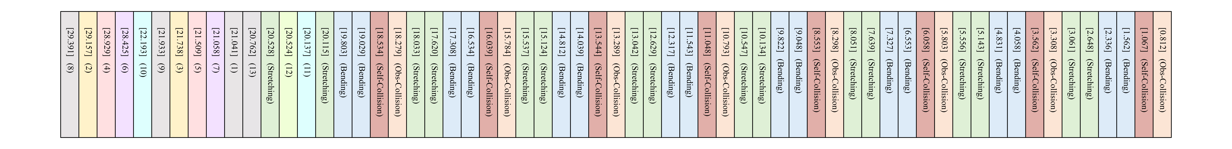
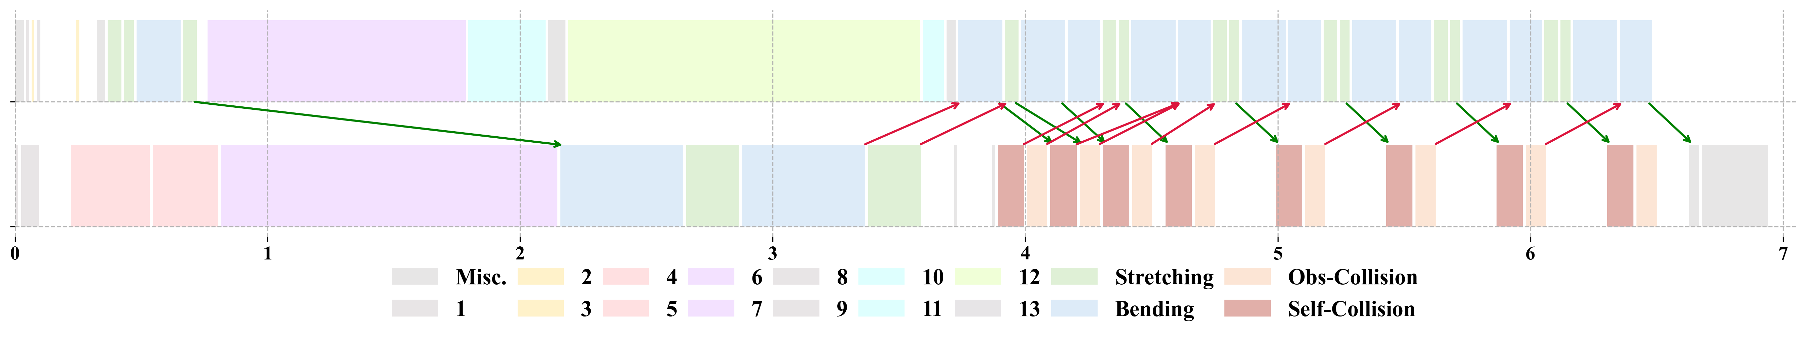
Maximize parallelism and convergence
3. Gauss-Seidel Ranku: Improve the convergence effect of simulation tasks
Notes:
, which is to use a fully serial iteration process DAG to calculate the ranku of iterative tasks. This ensures that different types of constraints are distributed more evenly over time, thereby ensuring that the solution of different types of constraints is more balanced

Slide 12
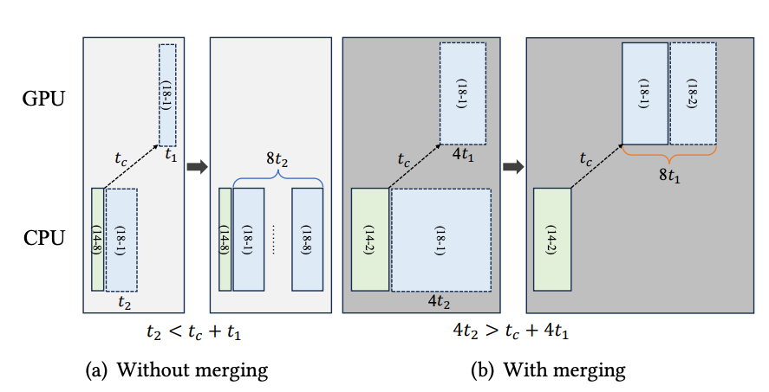
Maximize parallelism and convergence
4. Task merging in topology sorting
Color 1
Color 2
Color ……
Color N
Stretching
Notes:
In addition, as the HEFT is a heuristic algorithm, if the execution time of a single task is too short, the scheduling time may be more likely to fall into local optimum, resulting in an increase in global scheduling time. Therefore, we propose to perform a certain degree of task merging in the process of topological sorting to obtain better scheduling results

Slide 13
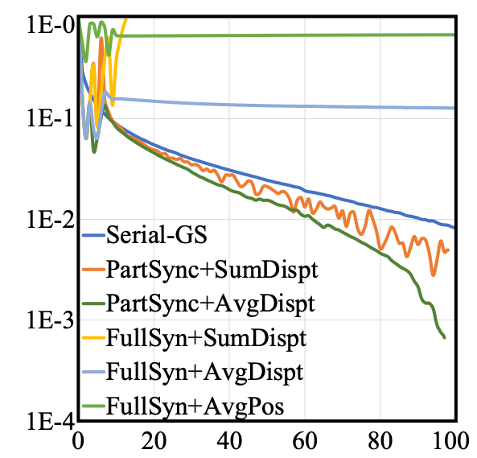
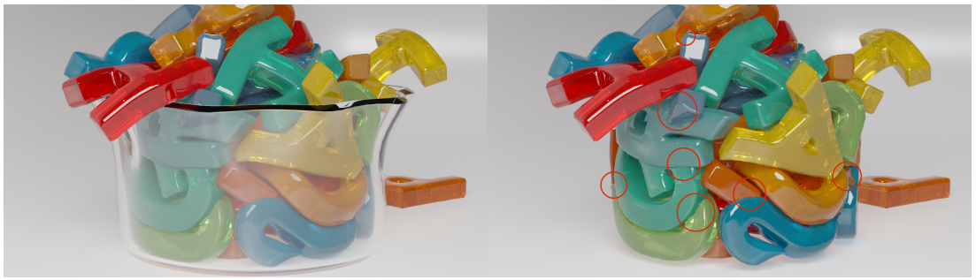
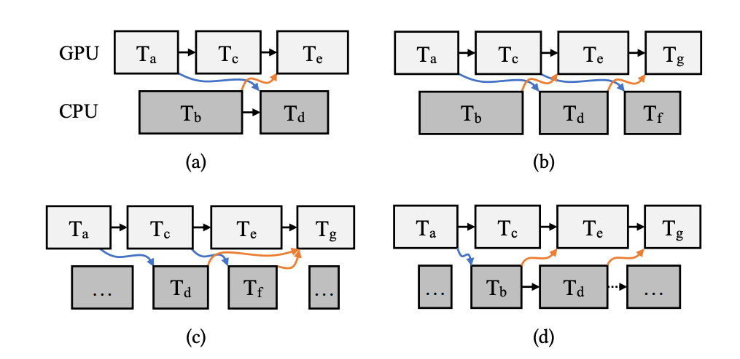
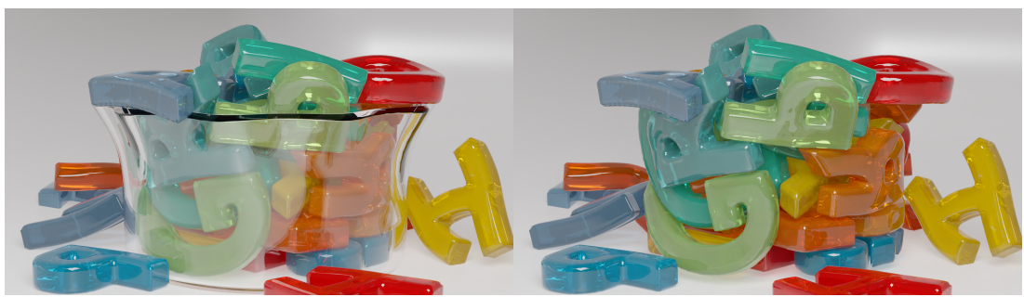
Maximize parallelism and convergence
5. Summarized different data flow situations, designed and compared different data transmission and conflict handling strategies
Averaging Positions
Data-Communication Case
Averaging Displacements
Notes:
Finally, we summarized the potential data flow between devices, designed and compared different data transmission and data weighting strategies, such as taking the average of relative displacement or the average of position, et cetera.
The results showed that taking the average of relative displacement is the best solution. In addition, calculating relative displacement requires us to know the common starting point of two iterative tasks, which can be found along our scheduling map. This is also one of the advantages of integrating iterative tasks into the HEFT scheduling framework.
In the end, we set up a faster convergence rate than synchronous iterative methods, while also having higher parallelism, which allows us to allocate iterative tasks to different devices for computation.

Slide 14
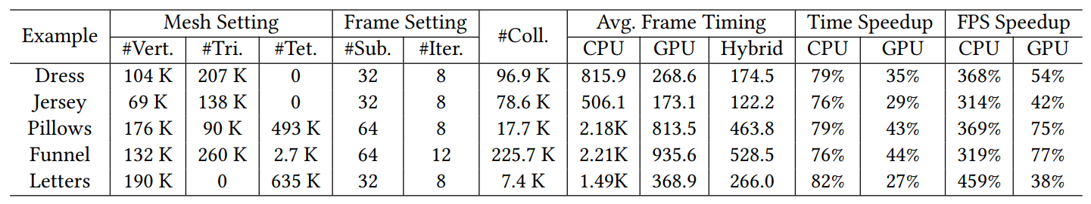
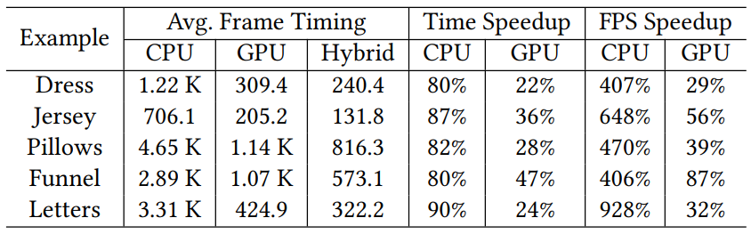
Speedup
M3 Max: 16 Core CPU, 40 Core GPU
M2 Max: 12 Core CPU, 30 Core GPU
Notes:
We validated our method in different scenarios and devices, and achieved an acceleration ratio of 300-500% compared to the CPU implementation and 40-80% compared to the GPU implementation on M3 Max SoC Chip.

Slide 15
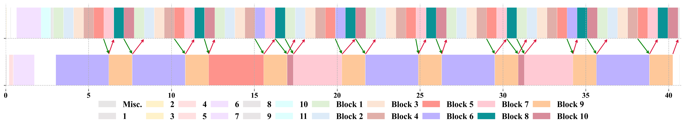
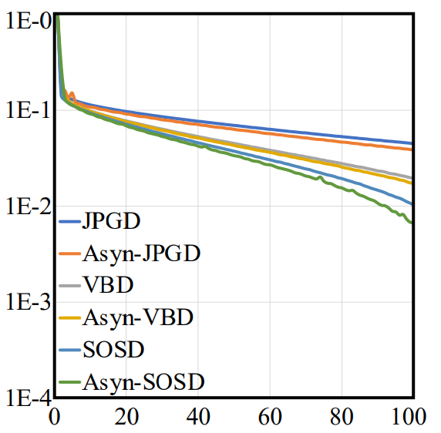
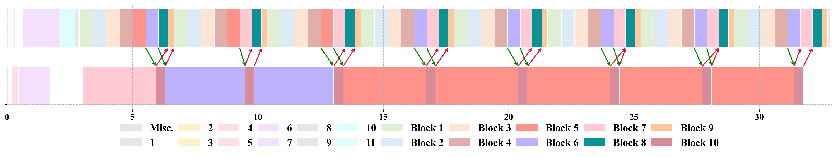
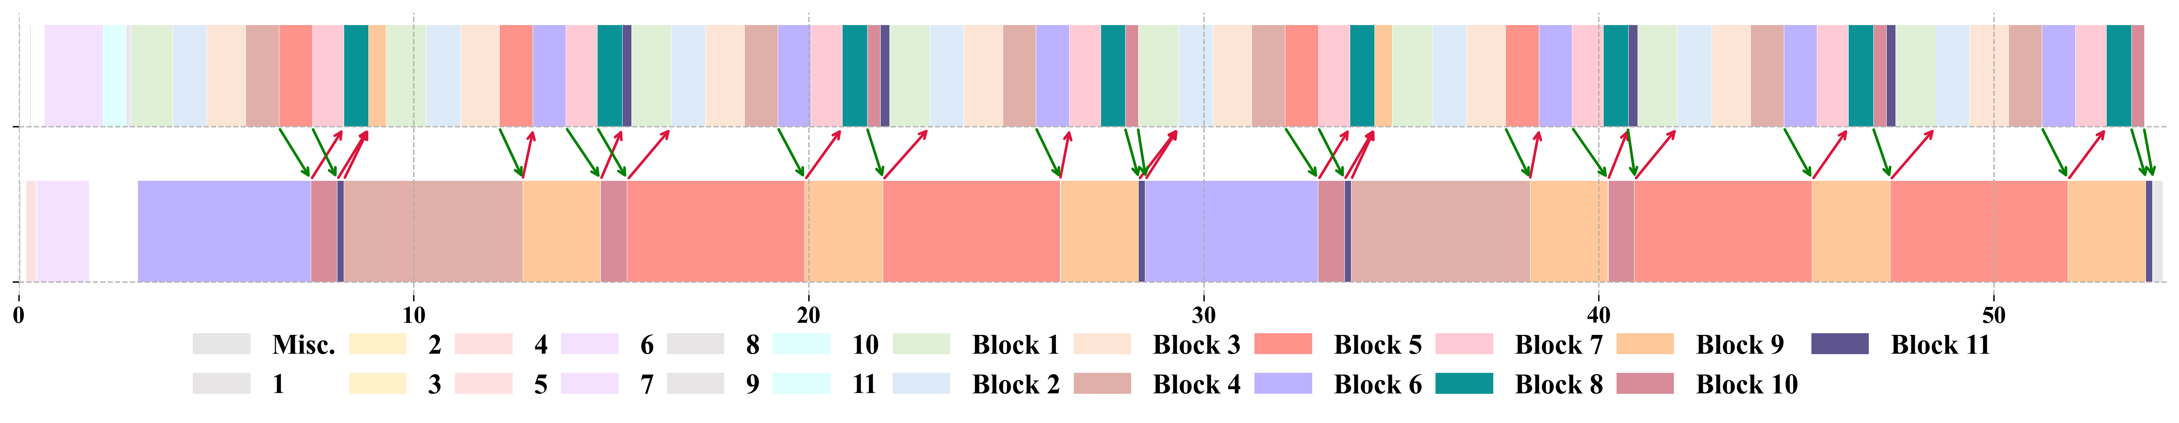
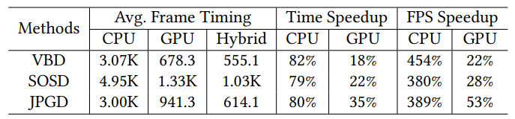
Promote to other simulation methods
Gradient Descent（SIG 2016）
Vertex Block Descent（SIG 2024）
Second-Order Stencil Descent（SIG 2023）
Notes:
In addition to XPBD, we have also tested our heterogeneous scheduling framework and asynchronous iteration under some cutting-edge nonlinear iteration processes, and have achieved certain acceleration effects.

Slide 16
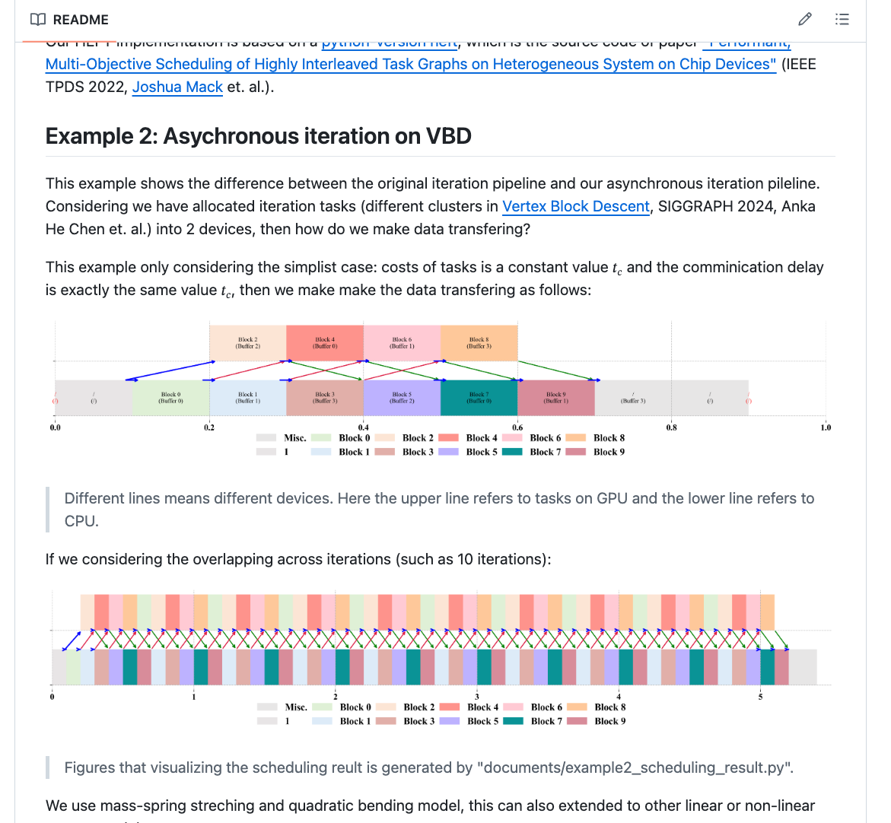
Future work
Cross-platform validation
Multiple-device optimization
Real-time parallel preconditioning
Other general computing scenarios
……
https://github.com/ChengzhuUwU/libAtsSim
Notes:
Although our approach demonstrates the potential of heterogeneous computing in physics simulation, there are still many directions worth further exploration
Although HEFT and asynchronous iteration algorithm are hardware independent, we have not further evaluated them on other heterogeneous platforms, such as independent graphics card that exchange data through PCIEs, due to our current GPU implementation being based on Metal Shading Language.
In addition, extending our task to multi GPU computing environments,
and real-time preconditioning techniques
and other general computing scenarios are also some very promising research directions
Our code has also been open sourced, and we welcome everyone to join the exploration of heterogeneous computing.

Slide 17
Thank you
Notes:
Thank you all for listening. Sorry again for not being able to come offline for face-to-face communication with everyone.

